Slide 1
Windows XP
Cody Baker
cody@codybaker.org

Slide 2
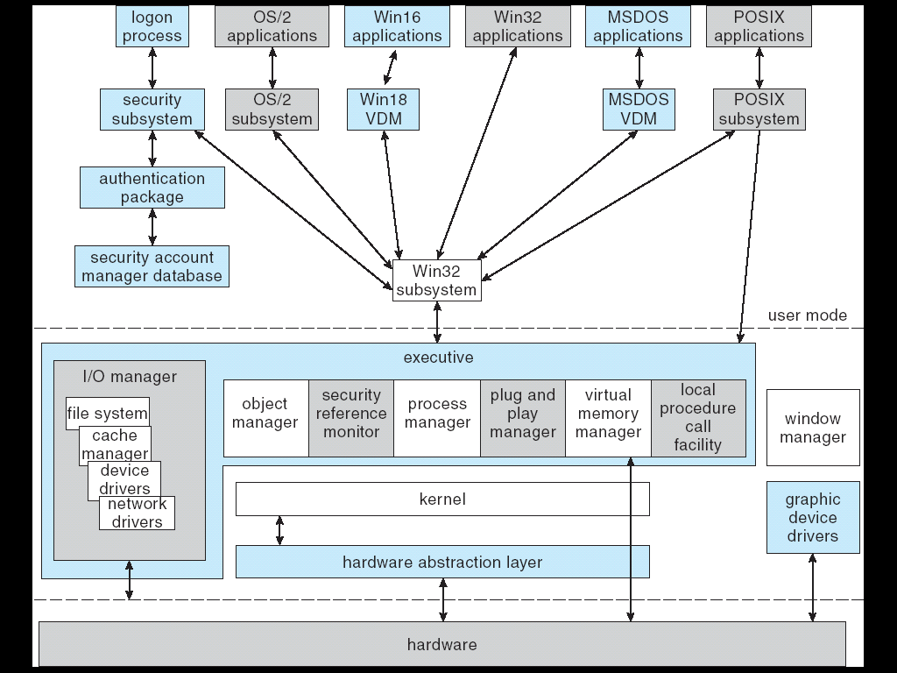
Structure

Slide 3
Win32 API Create Process
BOOL WINAPI CreateProcess(
LPCTSTR lpApplicationName,
LPTSTR lpCommandLine,
LPSECURITY_ATTRIBUTES lpProcessAttributes,
LPSECURITY_ATTRIBUTES lpThreadAttributes,
BOOL bInheritHandles,
DWORD dwCreationFlags,
LPVOID lpEnvironment,
LPCTSTR lpCurrentDirectory,
LPSTARTUPINFO lpStartupInfo,
LPPROCESS_INFORMATION lpProcessInformation );
Creates new process and it’s primary thread.

Slide 4
Wrapped API calls
MSDOS – create()
POSIX – fork()
WIN16 – CreateProcess()

Slide 5
Interprocess Communication
Clipboard – User-initiated shared memory
COM – Communication for apps supporting MS’s OLE (object linking & embedding).
Data Copy (Basic Message Passing)
DDE (Based on clipboard format, but doesn’t use global memory, can be passed over network)
File Mapping (Shared Memory)
Mailslots (One way message passing)
Pipes
  Anonymous Pipes (Often used by users to direct output of one process to another)
  Named pipes (Used to communicate between non-related processes, provides methods for communication across the network)
RPC – Remote Procedure Call
Windows Sockets – Based on Berkley BSD sockets

Slide 6
Processes & Scheduling
Preemptive multitasking scheduler
Processes
  Adjustable priorities and processor affinities
  Run independently of launching process and are not reaped upon the death of parent.

Slide 7
Win32 Thread/Fiber Creation
HANDLE WINAPI CreateThread(
LPSECURITY_ATTRIBUTES lpThreadAttributes,
SIZE_T dwStackSize,
LPTHREAD_START_ROUTINE lpStartAddress,
LPVOID lpParameter,
DWORD dwCreationFlags,
LPDWORD lpThreadId );
LPVOID WINAPI CreateFiber(
SIZE_T dwStackSize,
LPFIBER_START_ROUTINE lpStartAddress,
LPVOID lpParameter );

Slide 8
Threads
Threads
  Kernel Threads
  Win32 API
  Adjustable priorities
  Program can specifically order thread execution.
  “Fibers” used to easily port applications with user threads.

Slide 9
Citations
http://windowssdk.msdn.microsoft.com/

